Slide 1
A Virtual Reality-Cycling Training System for Lower Limb Balance Improvement
Journal: BioMed Research International 2016
Impact factor: 2.476

Slide 2
Introduction
1. Stroke survivors may have many complications after they survived, such as abnormal muscle tone(肌张力异常) and hemiparesis(偏瘫).
2. The bilateral sides of stroke patients are often asymmetric or imbalanced, which limit their balance ability and hinder them from coordinating both sides of their bodies during movements.
3. Many studies suggested that using cycling, as a rehabilitation tool, could significantly improve lower body extremity function of stroke patients.
4. Limitations:
(1) Cycling requires participants to move both of their lower limbs alternately with equal force.
(2) The unaffected limb may mask the insufficiency of the affected limb and result in uncoordinated training.

Slide 3
Introduction
5. VR with a proper feedback device can provide a safer and more interesting training method for the stroke patients.
6. The purpose of this study is to evaluate the training effect of customizable VR-Cycling Training System (VRCTS) for use in the rehabilitation of stroke patients.

Slide 4
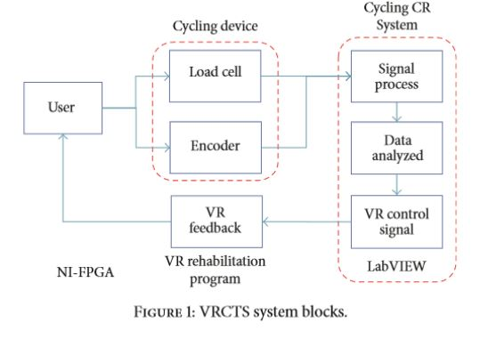
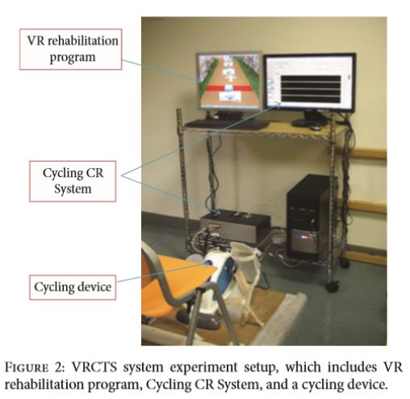
Methods
1. VR-Cycling Training System (VRCTS):

Slide 5
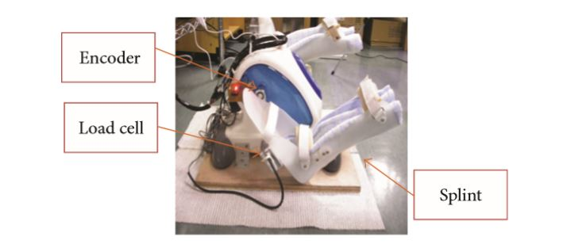
Methods
1. VR-Cycling Training System (VRCTS):
(1) Cycling device with sensors
(a) A cycling device
(b) Two load cells (测压头)
(c) An encoder

Slide 6
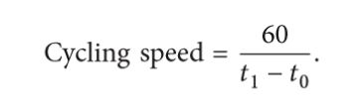
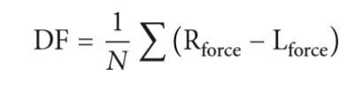
Methods
1. VR-Cycling Training System (VRCTS):
(2) Cycling Graph User Interface Control and Data Record System (Cycling CR System):
(a) Speed in rotations per minute(RPM)
(b) Difference Force(DF) between the two legs

Slide 7
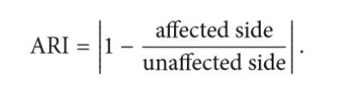
Methods
1. VR-Cycling Training System (VRCTS):
(2) Cycling Graph User Interface Control and Data Record System (Cycling CR System):
(c) Right turning point (RTP) = Standard deviation (SD) + The average positive DF.
(d) Left turning point (LTP) = Standard deviation (SD) - The average positive DF.
(e) Force ARI (Asymmetry Ratio Index):

Slide 8
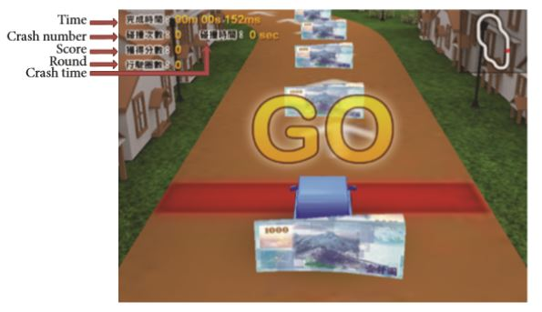
Methods
1. VR-Cycling Training System (VRCTS):
(3) VR rehabilitation program
(a) Virtools 4.0
(b) Three levels for speed control
(c) How to play:
DF<LTP => Turn left
DF>RTP => Turn right
Others => Go straight

Slide 9
Methods
2. Participants:
(1) 9 stroke patients were recruited from the Chung Shan Medical University Hospital.
(2) 6 in experimental group, 3 in control group.

Slide 10
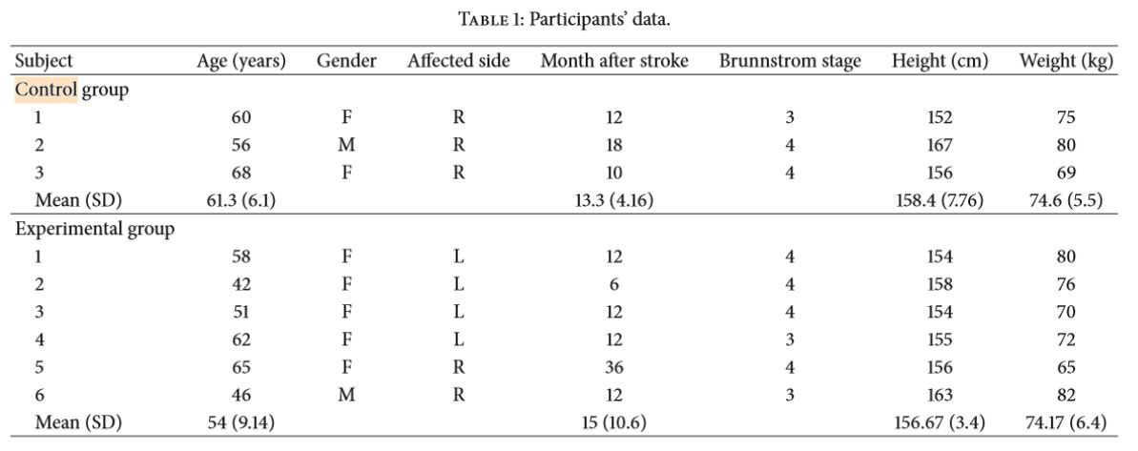

Slide 11
Methods
3. Procedure
(1) The control group and experimental group both had the same rehabilitation treatments five times per week,with time being for 1 hour.
(2) The experimental group also had VRCTS training besides their rehabilitation treatment three times a week for 15 minutes each time for a total of ten times.
(3) For VRCTS training, a pretest will be performed to help adjust the parameter in the VRCTS system.

Slide 12
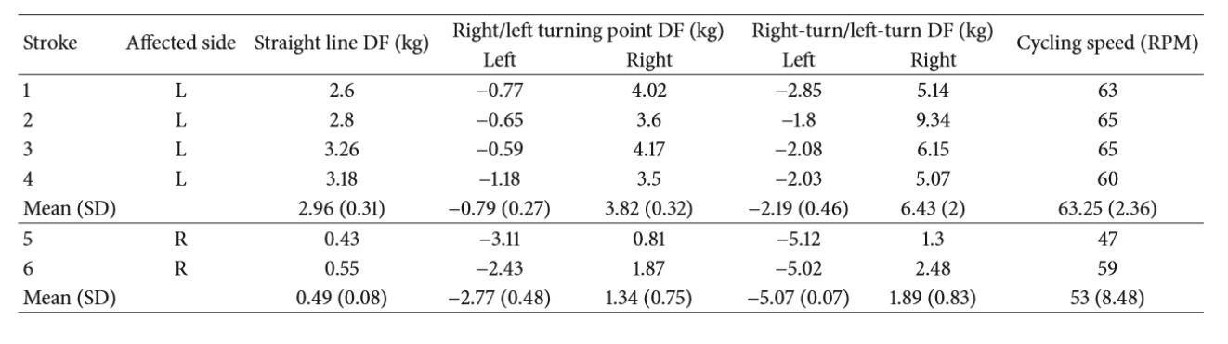
Results
1. DF in VR Rehabilitation Program

Slide 13
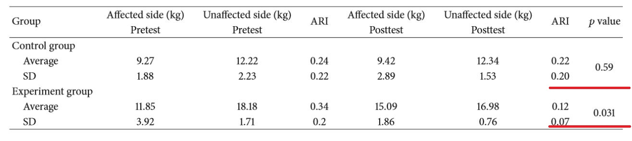
Results
2. Bilateral pedal force
(1) The pedal force symmetry had improved after training with the VRCTS.

Slide 14
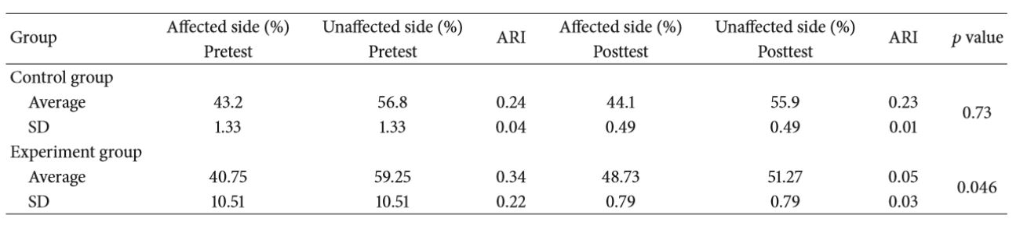
Results
3. Bilateral pedal force(percentage)
(1) After the VRCTS training, the standing balance ability has increased.
.

Slide 15
Conclusions
1. The results showed that after the VRCTS training, the stand balance had improved.
2. The treatment of the Virtual Reality Cycling Training System can increase the bearing symmetry in static balance effectively.

Slide 16
Limitations
1. Nonblind design.
2. Nonrandomized grouping.
3. The number of samples.

Slide 17
我们的论文的问题
1.训练方法是否有科学依据（前人论文）：
（1）双手握拳阻拦足球这一动作可以进行下肢平衡康复是否有依据？
（2）临床上（医院里）一般采用什么方法进行下肢平衡康复？
（3）双手握拳阻拦足球这一动作可以和临床上的什么康复动作等价？

Slide 18
我们的论文的问题
2.训练的难度设置有何科学依据：
（1）训练的5级难度如何定量化的区分开（如，和Berg量表得分对应）？
（2）评估的分数如何转化为训练计划的难度？

Slide 19
未来计划
2.修改论文

